Slide 1

Basics of Neural Network Programming
Vectorization
deeplearning.ai

Slide 2
Vectorization
Art of getting rid explicit for loops in the code.
We have large datasets, it is important that our code run quickly.
Ability to perform vectorization has become a key skill in deep learning era.

Slide 3
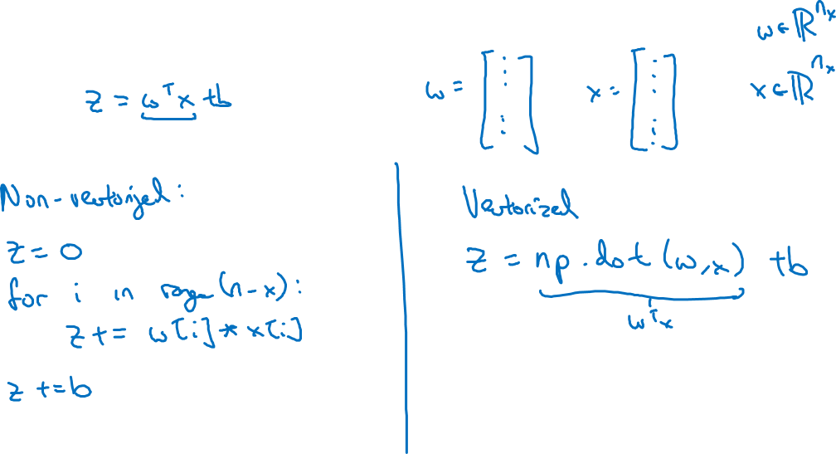
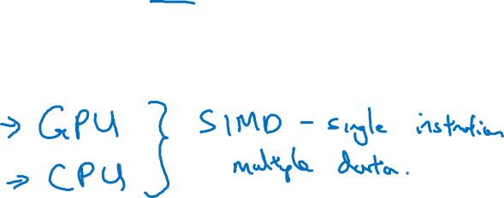
What is vectorization?

Slide 4
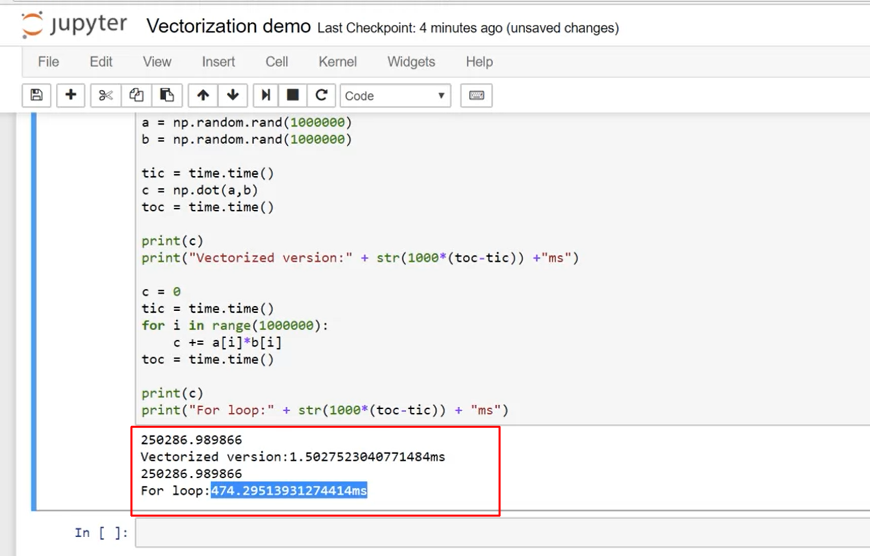
Vectorization Demo

Slide 5
SIMD
If we use built in functions that don’t require explicit for loops than it allows numpy to use parallelism on CPU & GPU.
GPUs are comparatively better than CPU in this realtion.
Whenever possible avoid

Slide 6
Basics of Neural Network Programming
More vectorization
examples
deeplearning.ai
Notes:
Use built in functions & avoid explicit for loops

Slide 7
Neural network programming guideline
Whenever possible, avoid explicit for-loops.
Notes:
Its not always possible to not to use for loop but whenever we can use a built in function we should use.

Slide 8
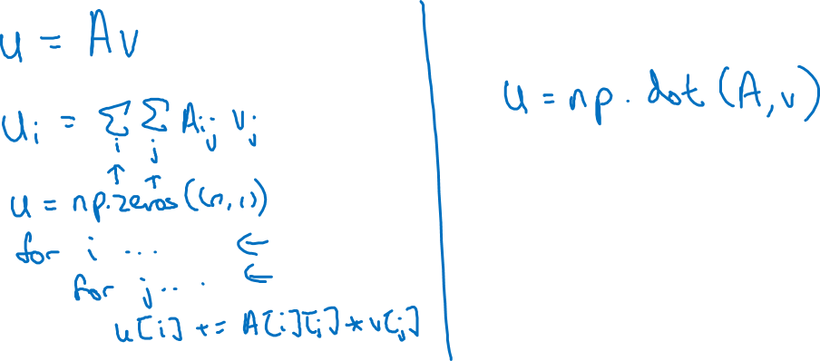
Neural network programming guideline
Whenever possible, avoid explicit for-loops.
Notes:
If ever we want to compute a vector u as product of a matrix A & another vector v
Than by definition of matrix multiplication:
ui = SUMi SUMj Aij * Vj
On the left hand side, we have determined the non vectorized implementation & on the right hand side we have implemented a vectorized implementation.
In the non-vectorized implementation we have 2 loops which we don’t have in vectorized implementation.
This is a nice trick to have /.

Slide 9
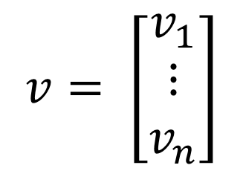
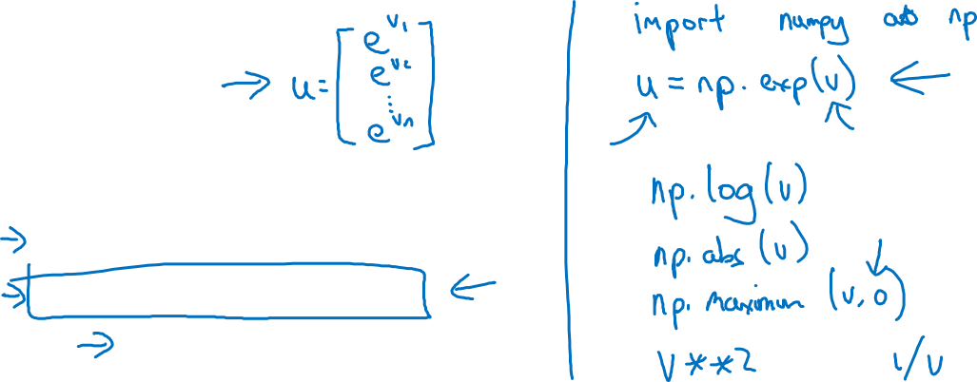
Vectors and matrix valued functions
Say you need to apply the exponential operation on every element of a matrix/vector.
$$v= \left[\begin{matrix}v_{1} \\ ⋮ \\ v_{n}\end{matrix}\right]$$
u = np.zeros((n,1))
for i in range(n):
u[i]=math.exp(v[i])
Notes:
Here we have again showed that vectorization gets rid of for loops, making the implementation faster.
Numpy has many other methods to apply operations in a vectorized fashion.
Whenever, we have the opportunity, we should apply numpy.

Slide 10
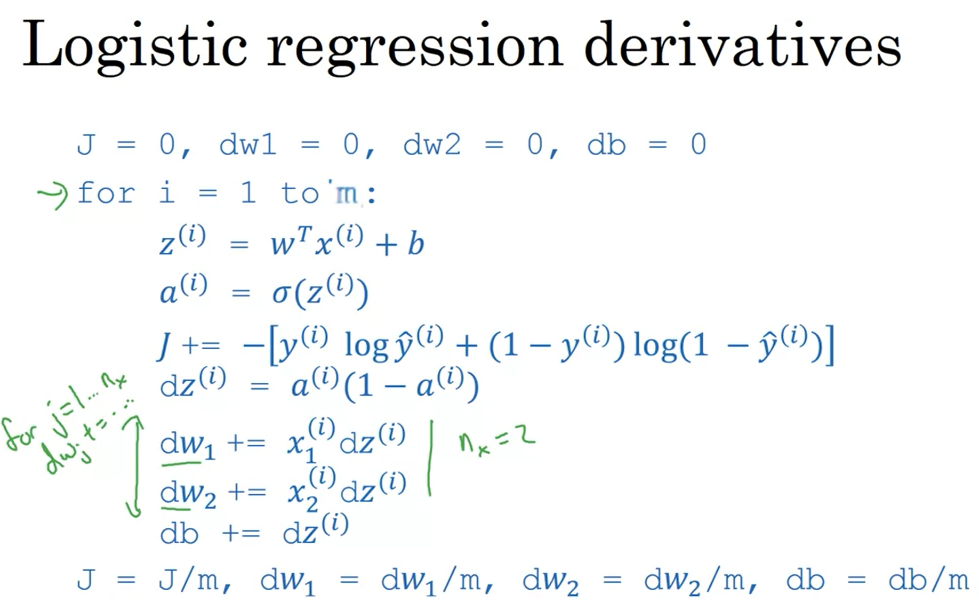
Lets try to remove for loops in logistic regression - 1
Notes:
One loop is for number of training examples.
2nd loop is for the number of features, where we are trying to loop for computing the x*dz computation.
We will try to remove the 2nd for loop.

Slide 11
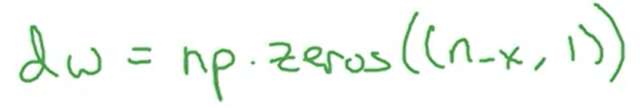
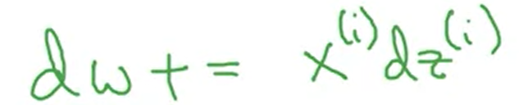
Lets try to remove for loops in logistic regression - 2
Instead of initializing the dw1 & dw2 to 0, we set dw to a vector.
We will use NumPy to initialize the dw vector & its order will be Nx, 1 which means there will be rows = number of features & one column. So for each feature it will have a dw.
Than in the for loop section, we are adding the x*dz computation to dw.
At the end we divide dw/m
Notes:
Lets write everything in English.
We have m examples & we train for each m example in a for loop.
In each iteration of this for loop, we need to calculate z which is a linear combination of x & weights.
Than we take sigmoid of this z value. This is our prediction.
Than we compute the loss for this prediction, adding to cost part.
Than in another for loop, we want to compute the gradient for each feature of x, i.e. we want to update the weights for each one,
Now normally , we would want to do it via a loop but since now we have seen a professor saying that its faster & than showing a demo to us morons we want to remove this for loop & instead do a vectorized operation. In this operation we perform the gradient & weight update.
We can do more in the next video.

Slide 12
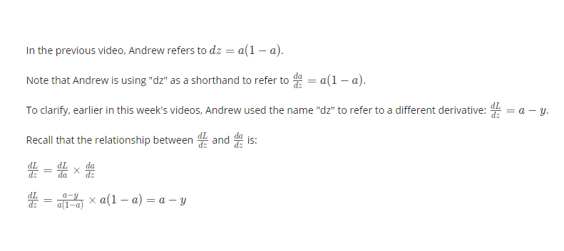
Clarification on usage of derivative terms

Slide 13

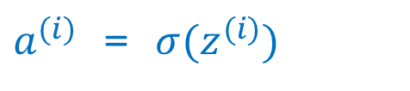
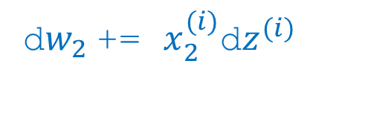
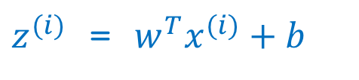
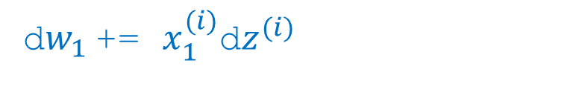
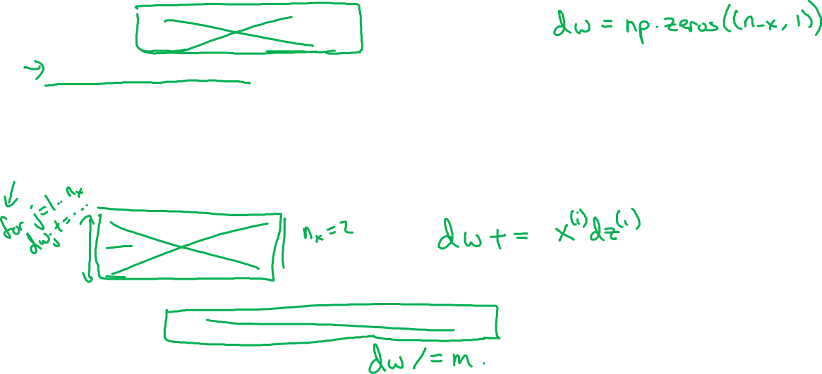
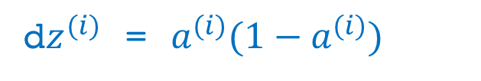
Logistic regression derivatives
J = 0, dw1 = 0, dw2 = 0, db = 0
for i = 1 to n:
$z^{(i)}$ = $w^{T}x^{(i)}+b$
$a^{(i)}$ = $σ{(z}^{(i)})$
$J$+= $−\left[y^{(i)} \log{{\hat{y}}^{\left(i\right)}+({1−y}^{\left(i\right)})\log{(1 −{\hat{y}}^{\left(i\right)})}}\right]$
d$z^{(i)}$ = $a^{(i)}{(1−a}^{(i)})$
d${w_{1}}^{ }$+= $x_{1}^{(i)}\text{d}z^{(i)}$
d${w_{2}}^{ }$+= $x_{2}^{(i)}\text{d}z^{(i)}$
db += d$z^{(i)}$
J = J/m, d$w_{1}$ = d$w_{1}$/m, d$w_{2}$ = d$w_{2}$/m, db = db/m

